Slide 1
ESCO vision and developments European Single Procurement Document OUC meeting 3 March 2021
Dimitrios Pikios
Project Coordinator ESCO
European Commission
DG Employment, Social Affairs and Inclusion
Unit E2 – Skills and Qualifications

Slide 2
EU goals in a digital labour market
Better link education-training to labour ensure access to the best opportunities
Ensure transparency of information on skills through systems’ interoperability
Allow open-fair access to information on skills, qualifications, jobs and training
avoid monopolisation of data in digital labour market
European open standards to counteract risks of proprietary standards

Slide 3
ESCO
European Skills, Occupations and Qualifications
3 000 Occupations
13 500
Skills + Knowledge

Slide 4
Early stage 2011-2017
Development of version 1.0, for use in systems providing services to end users
Close collaboration with stakeholders and Member State experts
Reference Groups for sectoral expertise and online consultation
Sources: national classification systems, reports, research papers, job vacancies

Slide 5
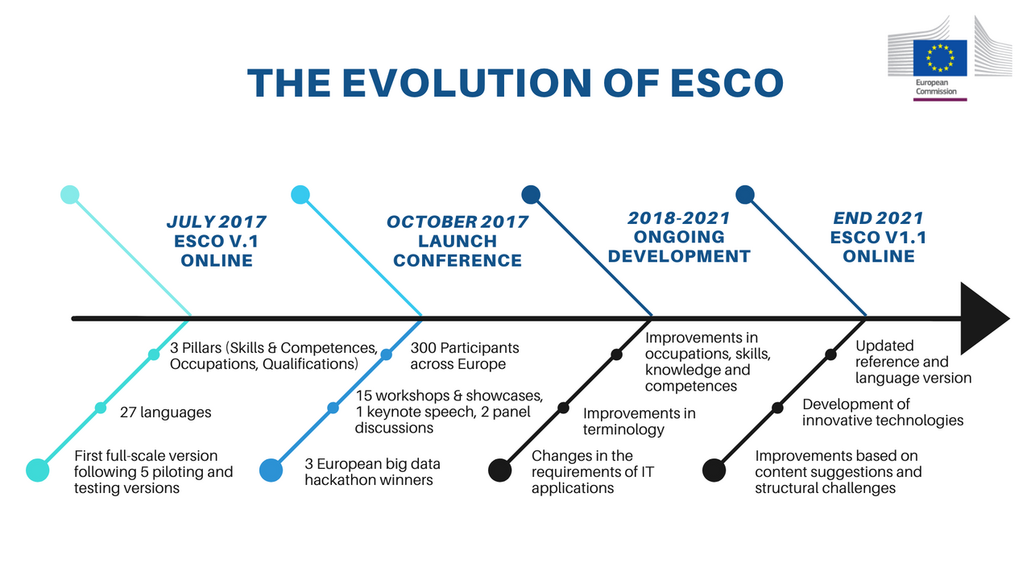

Slide 6


Slide 7
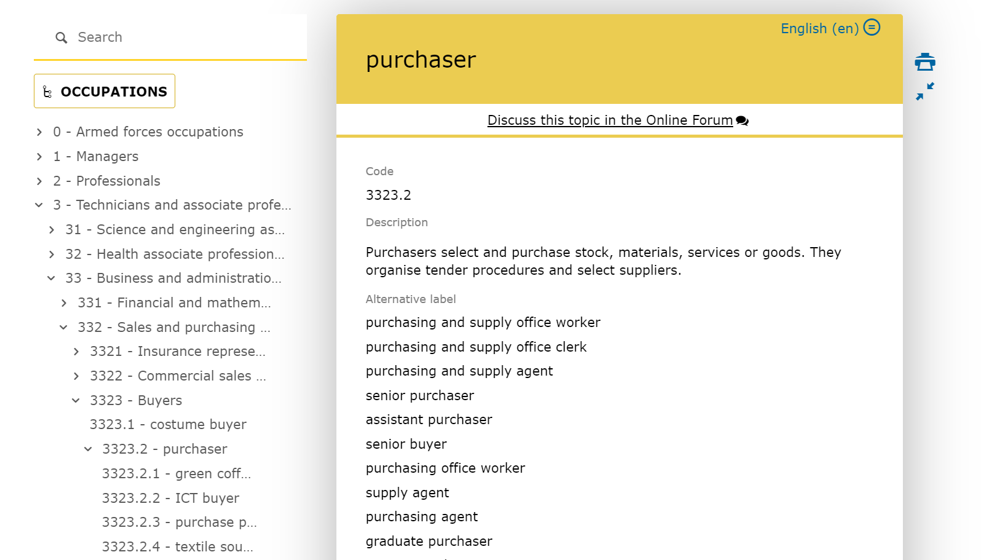

Slide 8
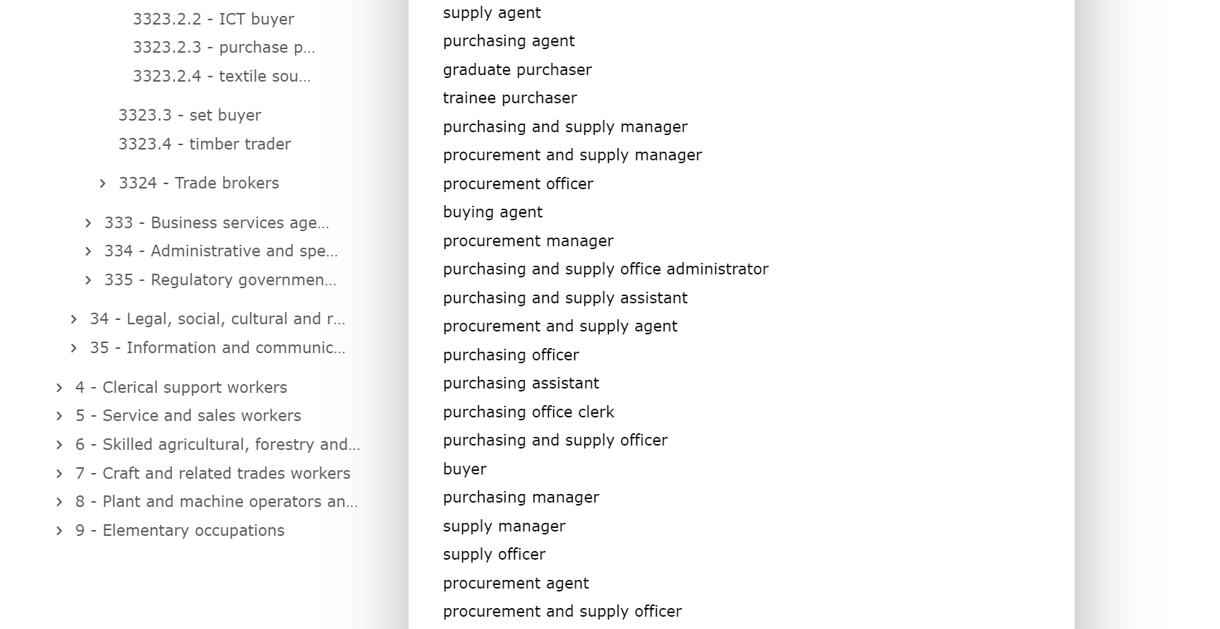

Slide 9
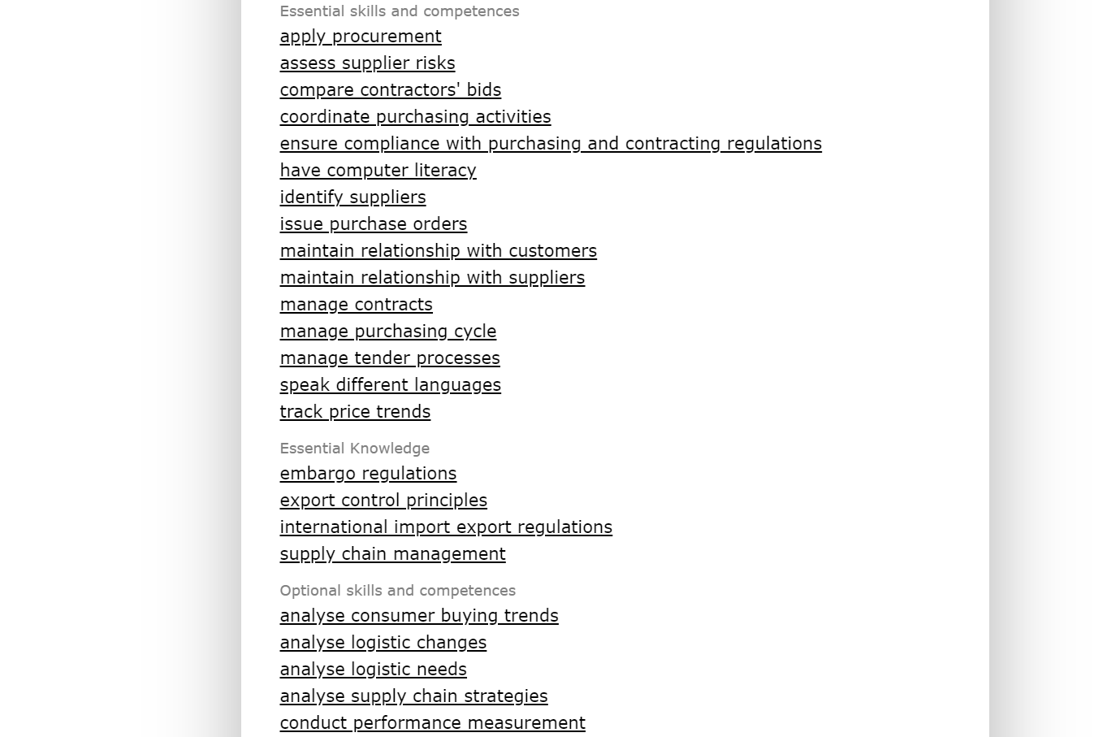

Slide 10
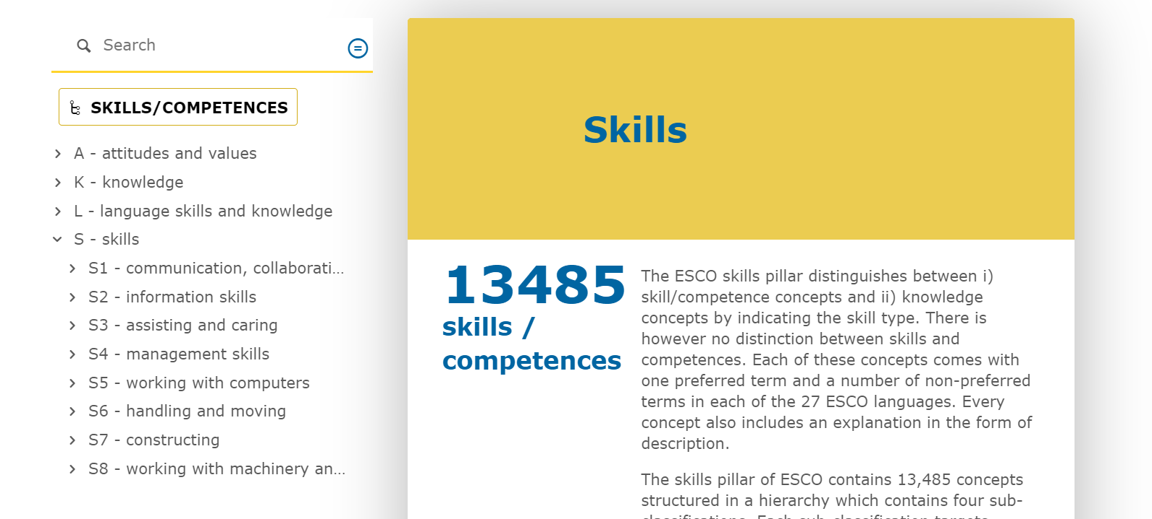

Slide 11
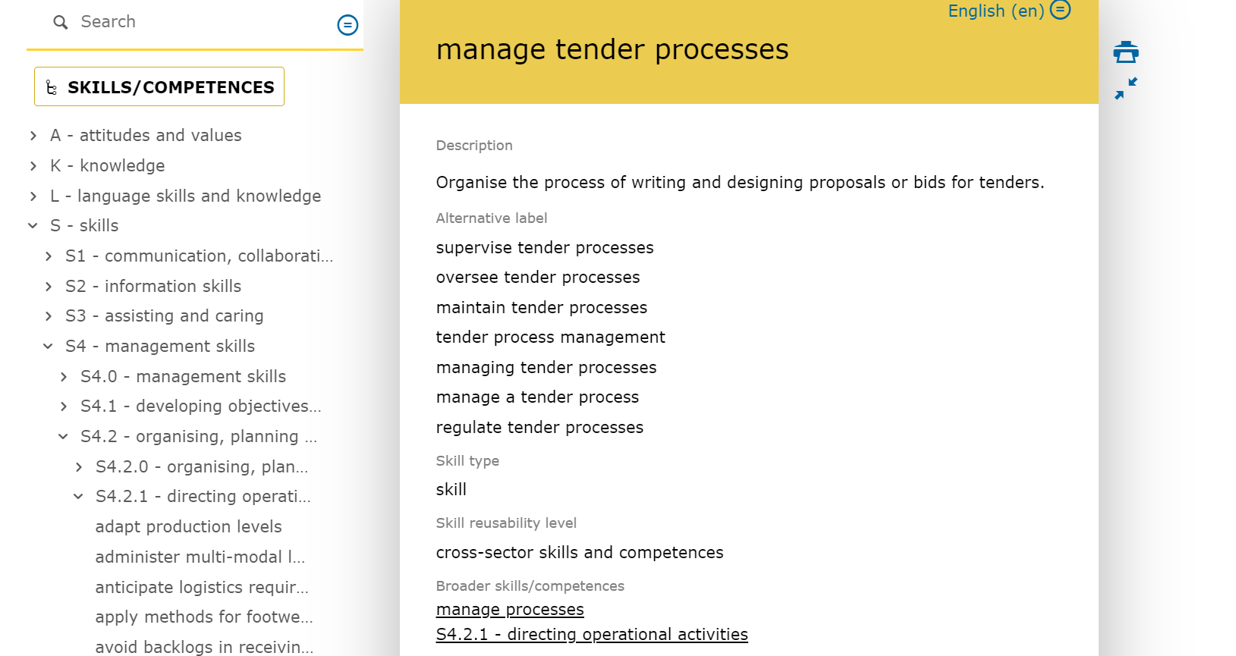

Slide 12
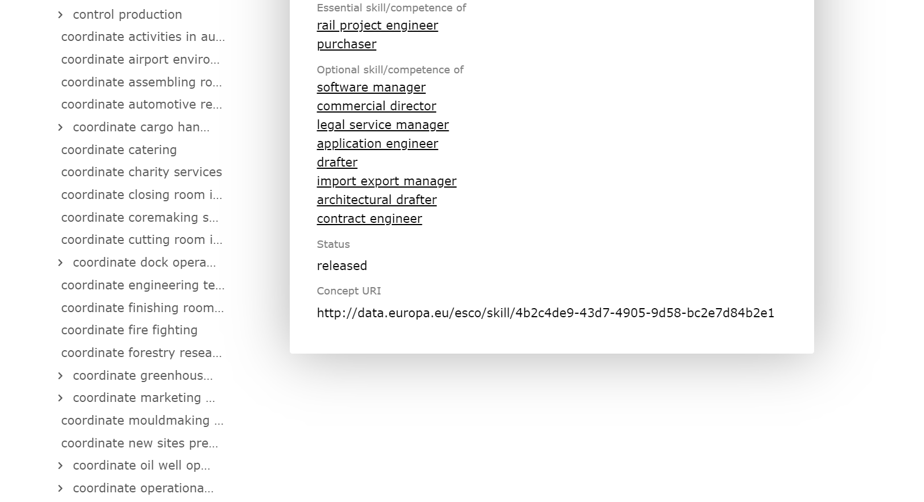

Slide 13
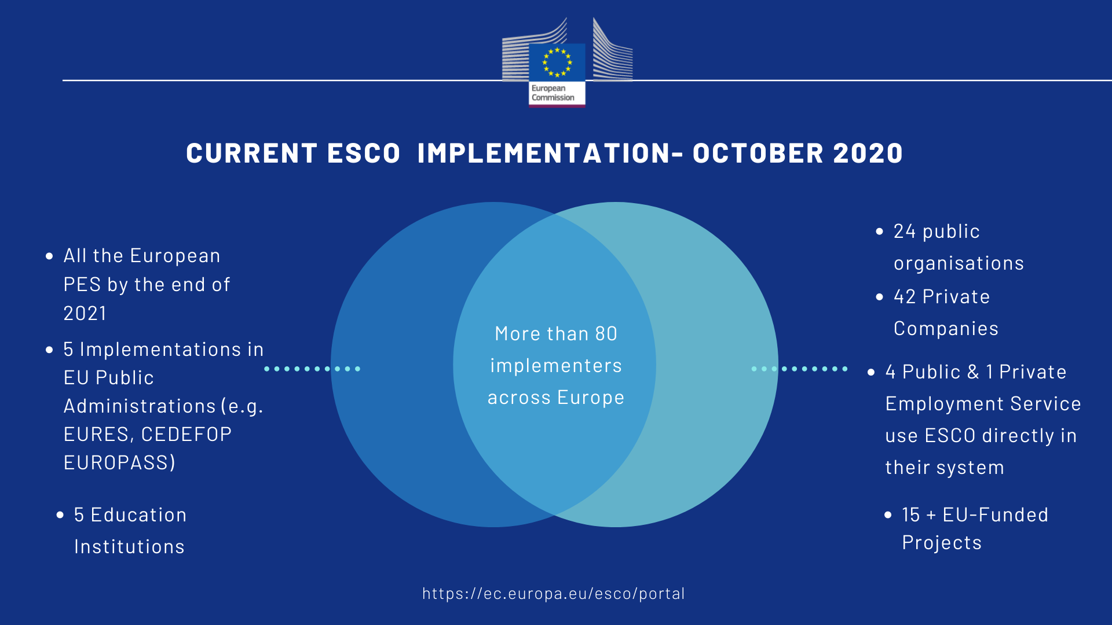
Job-matching and searching
Graduate tracking
Career learning & development management
Statistical research
Curricula development
Ontology management & machine learning
Validation of informal/non-formal/formal learning

Slide 14
Main ESCO developments
Development of skills hierarchy
Technical support for mapping
Communication and outreach
Preparation of ESCO version 1.1
ESCO’s future

Slide 15
Main purposes of the skills hierarchy
Search for and retrieve systematically the 13,485 ESCO skill and knowledge concepts to facilitate
Compilation of CVs and job vacancies
Annotation of qualifications
Mapping national classifications to ESCO
Creation of skill (self-)assessment tools
Provision of targeted career guidance
Matching jobseekers with job vacancies based on skills

Slide 16
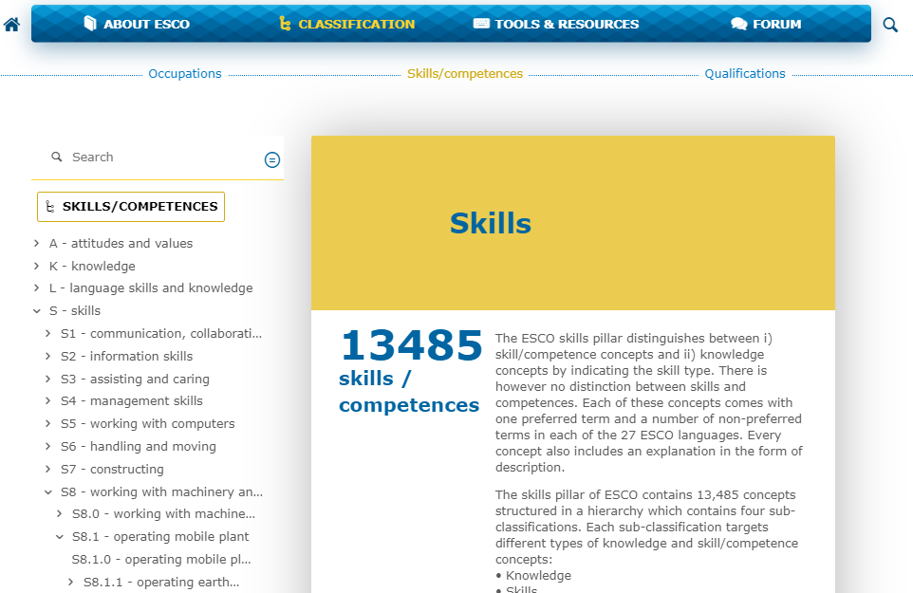
The skills hierarchy A new structure
Developed by experts in 2019 and published in May 2020
Structured in 8 groups and 3 levels
Sector-independent:
Tools and equipment used,
Type of object on which the work is performed
The function or outcome of the task or activity

Slide 17
Mapping to national skill and occupation classifications for interoperability
EURES platform operations for job mobility in Europe
3-year period - until August 2021
Mapping platform with suggested and manual matchings
Technical support with documentation, webinars and country visits
Online community forum for Member States

Slide 18
Communication and outreach
Five Country events in 2019: Greece, Slovenia, Poland, Cyprus and Italy
Study visits to ESCO implementers: Docebo, Boost.rs, Textkernel, Eures and Milch&Zucker
Monitoring of ESCO use by implementers via video calls

Slide 19
ESCO v1.1 Goals & approach
Updated and improved classification
Desk research & sectoral gap analysis
Quality review
Process and discuss feedback
Content creation & validation
ESCO needs to be kept up-to-date to reflect new realities in the labour market
Greening of the economy
Digitalisation and new technologies
COVID-19 changes
ESCO requires quality assurance activities (terminological issues, translations, etc.)

Slide 20
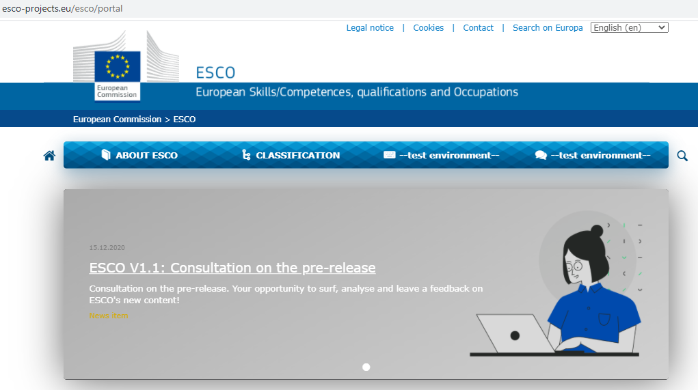
ESCO v1.1 Timeline and activities
MARCH –DECEMBER 2020
Updated and improved classification
JANUARY 2021
Open call for feedback (Maintenance Committee and external stakeholders)
FEBRUARY 2021
Consultation with Member States
MARCH – NOVEMBER 2021
Translation
Consultation with MS on translations
DECEMBER 2021
ESCO v1.1 goes live

Slide 21
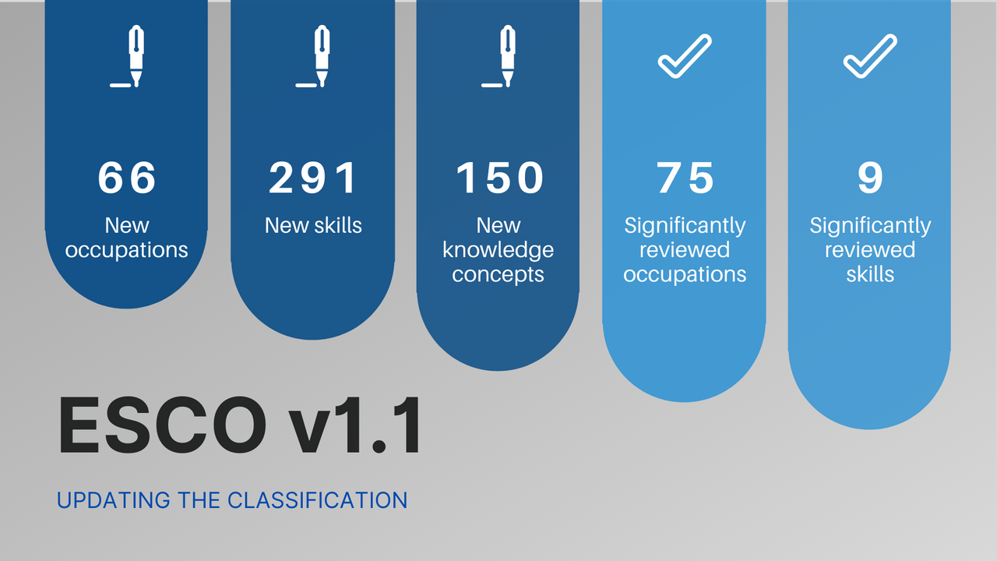
ESCO v1.1 Insights
Type | Label | Example
Digital | Occupation | Cloud engineer
Green | Occupation | Geothermal engineer
Other | Occupation | Contact tracing agent
Digital | Skill | Collect cyber defence data
Green | Skill | Apply procedures and regulations for eco-labelling
Other | Skill | Manage intellectual property rights
Digital | Knowledge | Advanced driver assistant systems
Green | Knowledge | Bioeconomy
Other | Knowledge | Social bonds

Slide 22
Data Science in ESCO
Use an analytical approach based on statistical analysis, data science and machine learning to assist in:
1) Making maintenance of ESCO more efficient
2) Expanding ESCO
3) Making ESCO easier to use by implementers

Slide 23
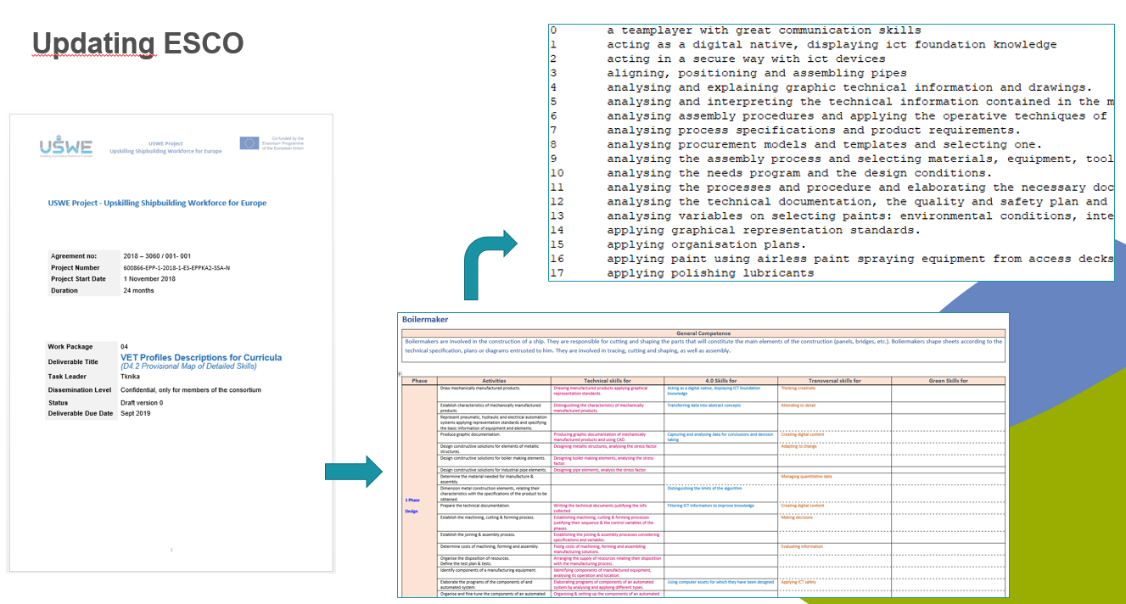
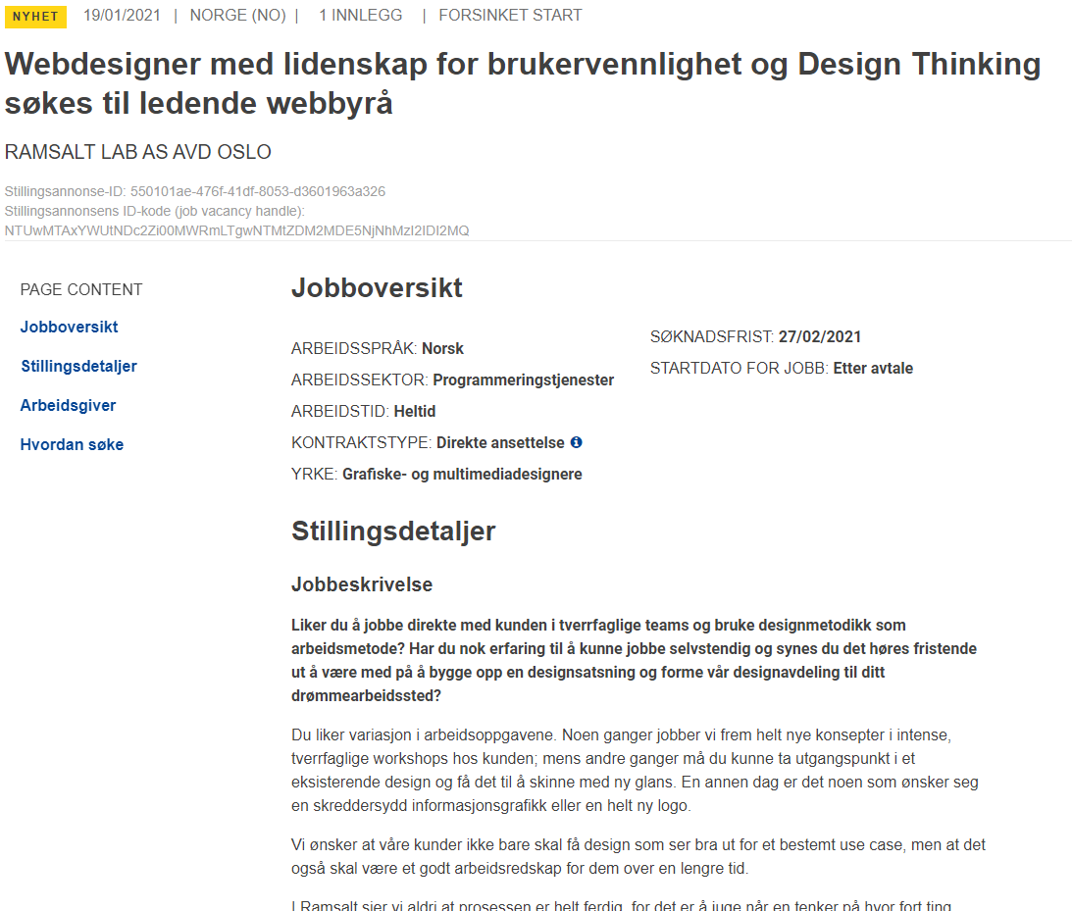
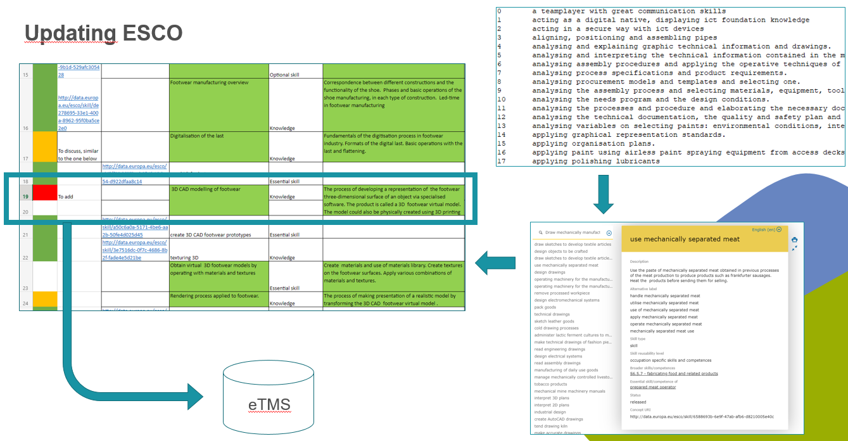

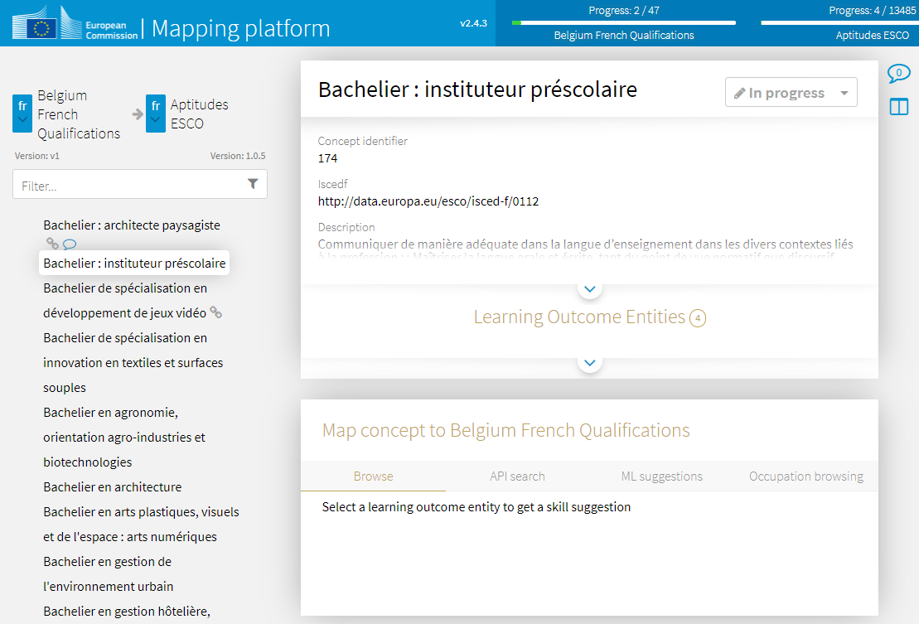
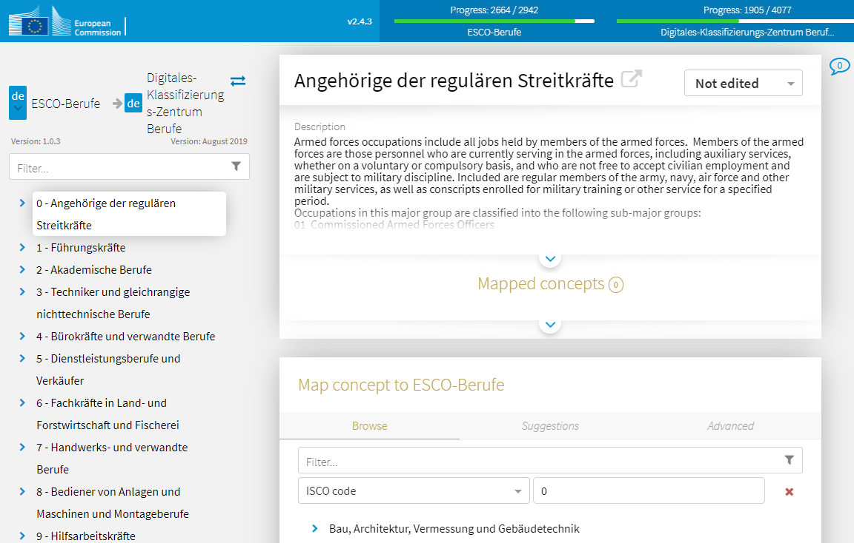
Beyond Experts: Mapping other Data Sources
Expert Data:
Blueprints
Projects
European associations
Companies
Vacancies
2
Taxonomies:
Member States
Qualifications
2

Slide 24

#ESCO_EU

empl-esco-secretariat@ec.europa.eu

Slide 25


